Slide 1

WELCOME TO YEAR 1 19TH SEPTEMBER 2025
Laurentiu Class Yomindee Class

Slide 2
MEETING
To introduce general information: uniform, P.E. kit, school timings.
To introduce the curriculum that your child will be covering in Year 1.
To identify the ways you can support your child in their learning at home.

Slide 3

CLASS TEACHERS AND SUPPORT STAFF
Laurentiu Class
Mrs Ciornei
Mrs Khokher
Yomindee Class
Mrs Ryatt
Ms Lacey
Mrs Bennett ART/DT Teacher
Mr Dowling PE Teacher

Slide 4

SCHOOL TIMINGS
Start time: 8:30am
Finish time: 3:15pm
Playground entrance (Furness Road) or field entrance (Welbeck Road).

Slide 5
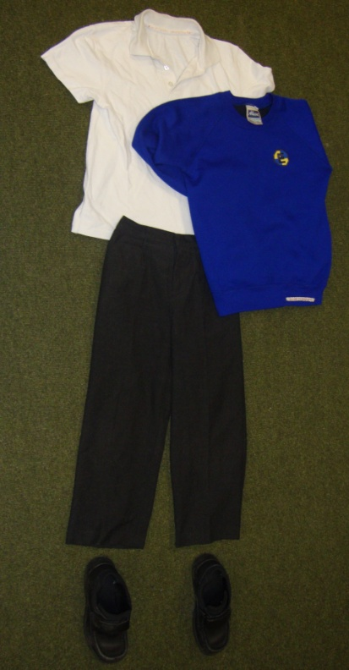
UNIFORM
White polo shirt
Blue jumper/cardigan
Grey skirt or trousers
Blue check summer dresses
Black shoes
No leggings
PLEASE ENSURE YOUR CHILD’S CLOTHES ARE LABELLED – ESPECIALLY JUMPERS/CARDIGANS

Slide 6


P.E. KIT P.E DAYS: TUES & THURS
White t-shirt
Blue or black shorts
Blue tracksuit
Trainers or plimsolls
PE lessons: Wednesday PE with Class Teacher, Thursday with Mr Dowling

Slide 7

PACKED LUNCHES
Packed lunches should contain:
Sandwich / pasta / rice etc.
Fruit
Yoghurt / biscuit etc.
Fruit juice or water
Packed lunches should NOT contain:
Nuts or food containing nuts
Fizzy drinks
Crisps
Chocolate / sweets

Slide 8

YEAR 1 CURRICULUM
English: Phonics, writing, reading & comprehension, grammar and punctuation, spelling.
Maths: Place value, addition and subtraction, money, multiplication and division, shape, fractions, measurement, time.
Science: Animals including humans, everyday materials, seasonal changes,
History: Past and present, significant individuals and events, history of holidays.
Geography: Maps, comparison of the U.K. and Peru, seven continents and five oceans.
Art & D.T.: Drawing, mechanism, painting, printing and textiles, food technology.
Music: Singing, beat competency and rhythm skills, coordination rhythm patterns.
P.E.: Coordination, dynamic and static balance, agility.
PSHE: Respecting rights, healthy living, celebrating difference, relationships
Computing: Online safety, grouping and sorting, coding, technology outside school.

Slide 9

ENGLISH
Reading
In-school and at home –Phonics Book and Library Book
Reading books to be sent home on Friday and returned a week later, the following Wednesday
Spelling
Practised in school, set for home learning, assessed in-school
Writing
Writing to entertain
Writing to inform
Punctuation and grammar
Handwriting

Slide 10

MATHS
Mastering Number
Place value within 100
Addition and subtraction within 20
Geometry (2D and 3D shapes)
Measurement (length & volume and weight & height)
Multiplication and division
Fractions
Money
Time

Slide 11

HOME LEARNING
All work will be set on Purple Mash/Spelling Shed/Spelling book – to be completed online and in Homework book
Set on Fridays due on Wednesday
Reading should be done every day during the week and recorded in reading diaries- Phonics Book
Spellings will be recorded in spelling books for practise at home – tests will be on Wednesdays
Knowledge organisers shared detailing what will be covered in-school.
Behaviour recorded in ClassCharts- login letter given to parents
Please support your child with their learning at home

Slide 12
Communication with the school
Weekly Newsletters detailing key events and important dates in the school calendar. It also celebrates top spellers on Edshed.
Youtube channel contains videos with important messages for the Grange community
Each class has a parent representative who is the admin of a class wassap group. They will also communicate some information through the group.
If you would like to contact us please email us on yr1@grange.harrow.sch.uk

Slide 13
PHONICS SCREENING NEXT YEAR JUNE 2026 THANK YOU!

