Slide 1
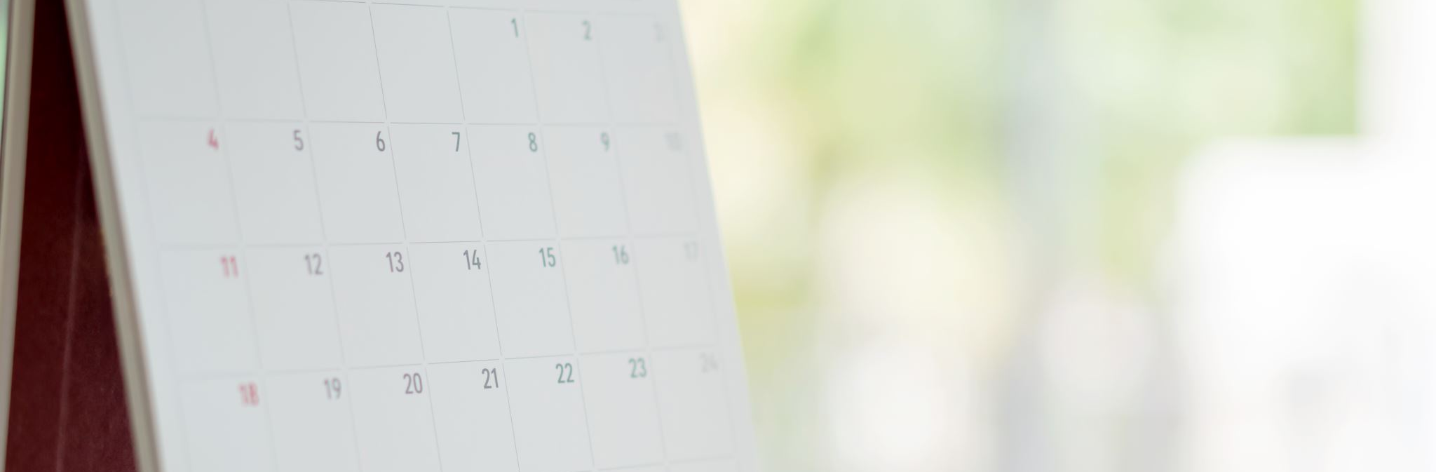
Welcome to Reception
9th October 2025
Cosmina and
Ana Maria classes

Slide 2
Meeting
To introduce general information: uniform, P.E. kit, school timings.
To introduce the curriculum that your child will be covering in Reception.
To identify the ways you can support your child in their learning at home.

Slide 3

Class Teachers
Mrs Matesescu
Miss Obilade
Educators
Ms Meena
Mrs Savage

Slide 4

School timings
Start time: 8:30am
Finish time: 3:15pm
All children enter via the field entrance (Welbeck Road).

Slide 5
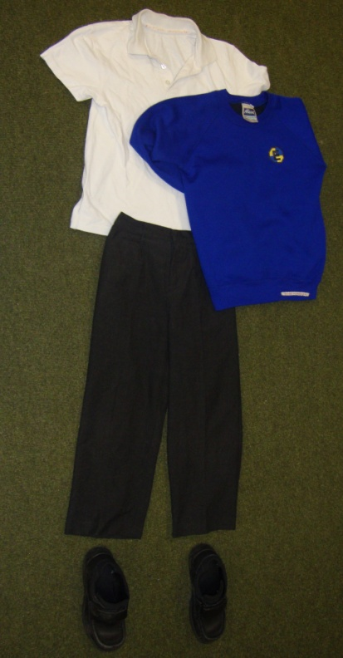
Uniform
White polo shirt
Blue jumper or cardigan
Grey skirt or trousers/jogging bottoms
Blue check summer dresses
Black shoes
No leggings
PLEASE ENSURE YOUR CHILD’S CLOTHES ARE LABELLED – ESPECIALLY JUMPERS

Slide 6
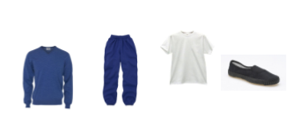

P.E. Kit
PE is on Thursdays
White t-shirt
Blue or black shorts
Black or blue tracksuit
Trainers or plimsolls

Slide 7
Spare clothes
Please send a spare set of clothes including the following to be kept at school in case of an accident:
Underwear
Jogging bottoms
Skirt
Socks
Shoes

Slide 8

packed lunches
Packed lunches should be healthy and contain:
Sandwich / pasta / rice etc.
Fruit
Yoghurt / biscuit etc.
Fruit juice or water.
Packed lunches should NOT contain:
Nuts or food containing nuts.
Fizzy drinks.
Crisps.
Chocolate / sweets.

Slide 9

Reception Curriculum
The Early Years Foundation Stage Curriculum consists of seventeen areas of learning based on Development Matters document.
Topics cover all areas of learning. These change each half term. We also follow the children’s interests to ensure that children engage in their learning.
The first half- term we will be focussing on social skills and getting to know the children.
We do lots and lots of practical activities
Most of the children’s learning is initially play based.

Slide 10

Home learning
Sent on Friday and due on Wednesday
Please hear your child read & sign the reading log daily.
Please make sure your child completes all homework as independent as possible
Children must bring a book bag into school on Wedesday with homework completed and both books returned.

Slide 11
How you can support your child?
Hear them read or read to them daily.
Sing songs with them
Talk to them during the school run and when at home to build up their communication skills
Support them to become independent, organised and ready for school.
Reward your child at home with class chart points when they complete tasks & for daily reading. The office can support with access should you have difficulty.

Slide 12
Thank you!

